Slide 1
Database Systems for Data Science
Prof. Saed SAYAd
CS527

Slide 2

Applications of Database Technology

Slide 3
Key definitions
A database can be defined as a collection of related data items within a specific business process or problem setting
has a target group of users and applications
A Database Management System (DBMS), is the software package used to define, create, use and maintain a database
consists of several software modules
DBMS
Databases
Tables
Columns and Rows
Values (data)

Slide 4
File versus Database Approach to Data Management
File approach
Procedure FindCustomer;
Begin open file Customer.txt;
Read(Customer)
While not EOF(Customer)
If Customer.name='Bart' then
display(Customer);
EndIf
Read(Customer);
EndWhile;
End;
Database approach (SQL)
SELECT *
FROM Customer
WHERE name = 'Bart'

Slide 5
Data Model
A data model provides a clear and unambiguous description of the data items, their relationships and various data constraints.
There are four types of data model or schema:
Conceptual
Logical
Physical
External

Slide 6
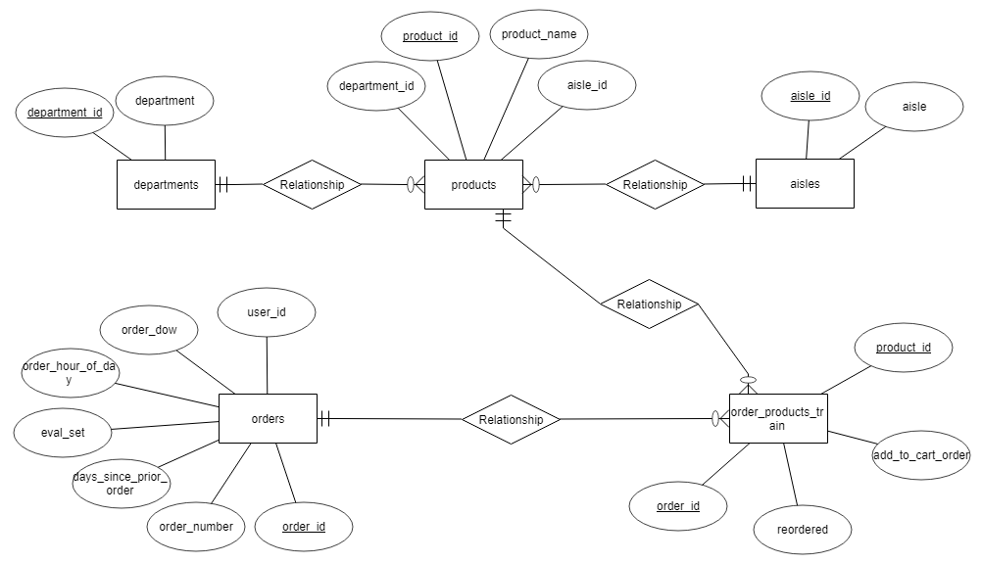
Data Model - Conceptual

Slide 7
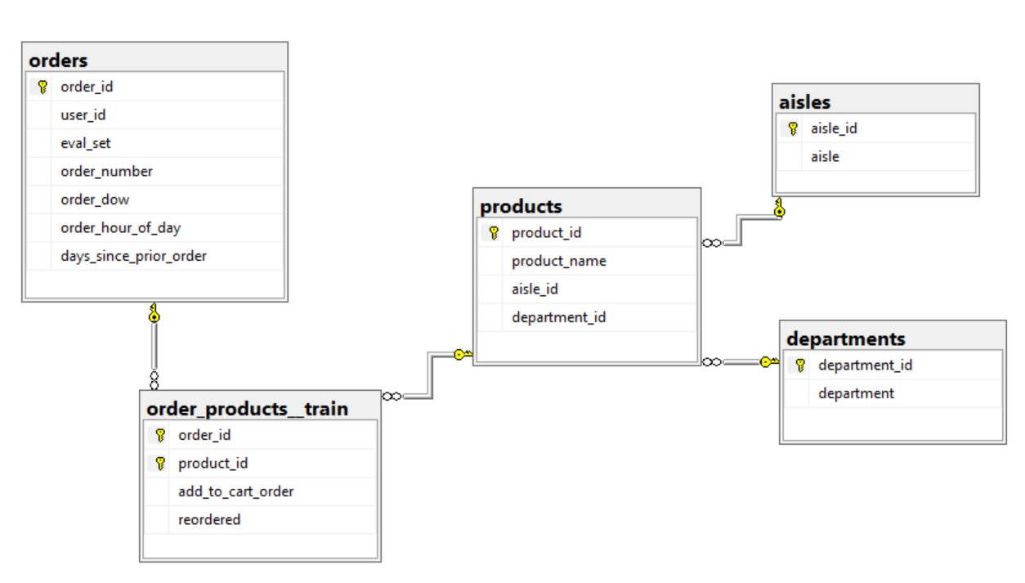
Data model - Logical

Slide 8
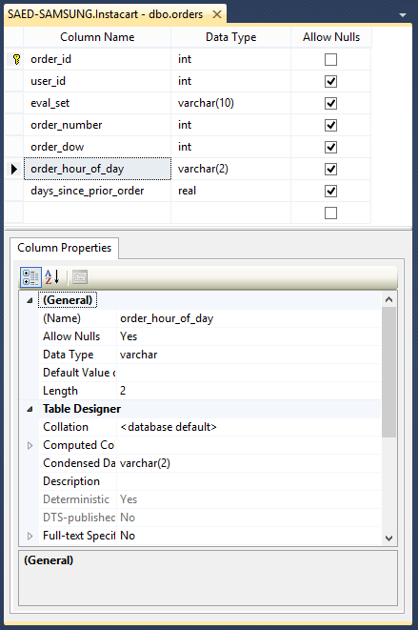
Data Model - Physical
Physical data model represents how the model will be built in the database
A physical database model shows all table structures, including column name, column data type, column constraints, primary key, foreign key, and relationships between tables
Convert entities into tables
Convert relationships into foreign keys
Convert attributes into columns

Slide 9
Data Model - External
External data model contains various subsets of the data items in the logical model, also called views, tailored towards the needs of specific applications or groups of users
SELECT
order_id
,user_id
,eval_set
,order_number
,order_dow
,[order_hour_of_day
,days_since_prior_order
FROM
orders
CREATE VIEW vw_orders_train
AS
SELECT
order_dow, count(*)
FROM
orders
GROUP BY
order_dow
ORDER BY
order_dow

Slide 10
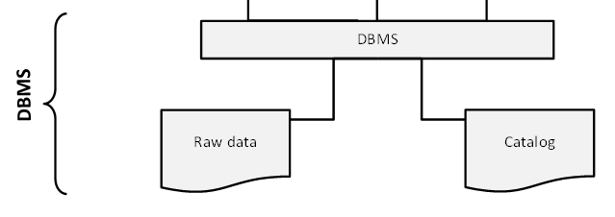
Catalog
Heart of the DBMS
Contains the data definitions, or metadata, of your database application
Stores the definitions of the views, logical and internal data models, and synchronizes these three data models to make sure their consistency is guaranteed

Slide 11
Database Users
Information architect designs the conceptual data model
Database designer translates the conceptual data model into a logical and physical data model
Database administrator (DBA) is responsible for the implementation and monitoring of the database
Application developer develops database applications in a programming language such as Java or Python
Business user will run these applications to perform specific database operations

Slide 12
Database Languages
Data Definition Language (DDL) is used by the DBA to express the database's external, logical and internal data models
definitions are stored in the catalog
Data Manipulation Language (DML) is used to retrieve, insert, delete, and modify data
DML statements can be embedded in a programming language, or entered interactively through a front-end querying tool
Structured Query Language (SQL) offers both DDL and DML statements for relational database systems

Slide 13
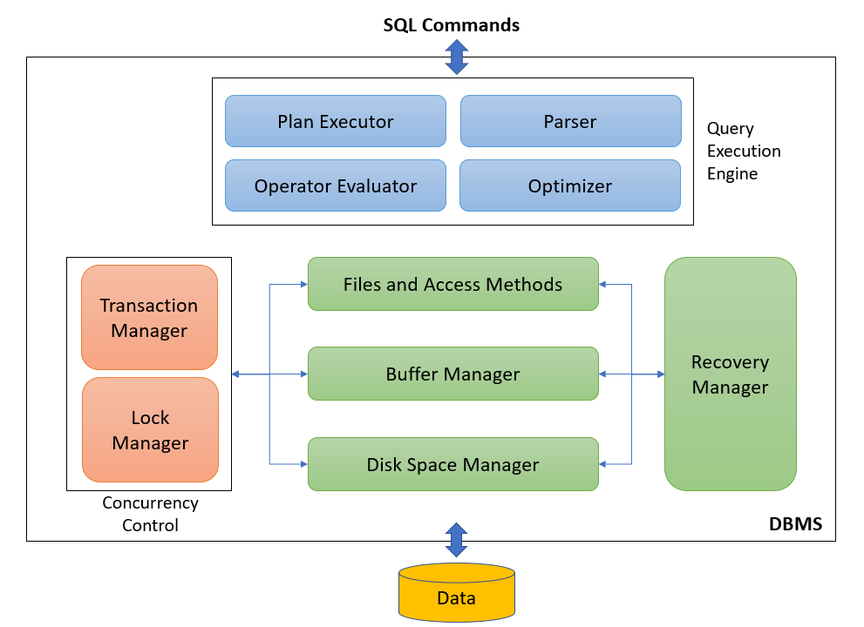
Database Management System

Slide 14
Transactions
Transaction is a set of database operations induced by a single user or application, that should be considered as one undividable unit of work
A transaction is a sequence of reads and writes, e.g., For example, transfer between two bank accounts of the same customer
Transaction always ‘succeeds’ or ‘fails’ in its entirety
Transaction renders database from one consistent state into another consistent state
Explicitly: begin_transaction and end_transaction
Implicitly: first executable SQL statement

Slide 15
ACID
Atomicity – shouldn’t take money from A without giving it to B
Consistency – money isn’t lost or gained
Isolation – other queries shouldn't see A or B change until transaction is completed or rolled back
Durability – the money does not go back to A is transaction was marked as committed
Transfer $50 from account A to account B:
Read(A)
A-=50
Write(A)
Read(B)
B+=50
Write(B)

Slide 16
Failure & Recovery
Transaction failure results from an error in the logic that drives the transaction’s operations and/or in the application logic
System failure occurs if the operating system or the database system crashes
Media failure occurs if the secondary storage is damaged or inaccessible
Recovery: activity of ensuring that, whichever of the problems occurred, the database is returned to a consistent state without any data loss afterwards
Log File

Slide 17
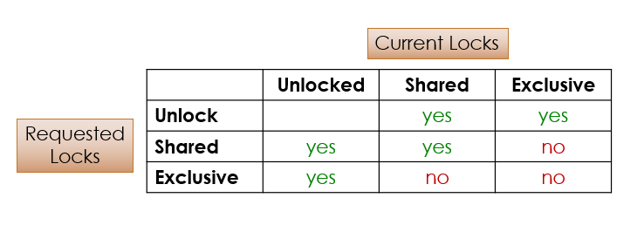
Concurrency- Exclusive and Shared Lock
An exclusive lock (x-lock or write lock) means that a single transaction acquires the sole privilege to interact with that specific database object at that time. No other transactions can read or write it.
A shared lock (s-lock or read lock) guarantees that no other transactions will update that same object for as long as the lock is held. Other transactions may hold a shared lock on that same object as well, however they are only allowed to read it.

Slide 18
Advantages of Database Systems and Database Management
Data Independence
Managing Structured, Semi-Structured and Unstructured Data
Managing Data Redundancy
Specifying Integrity Rules
Concurrency Control
Backup and Recovery Facilities
Data Security
Performance Utilities

Slide 19
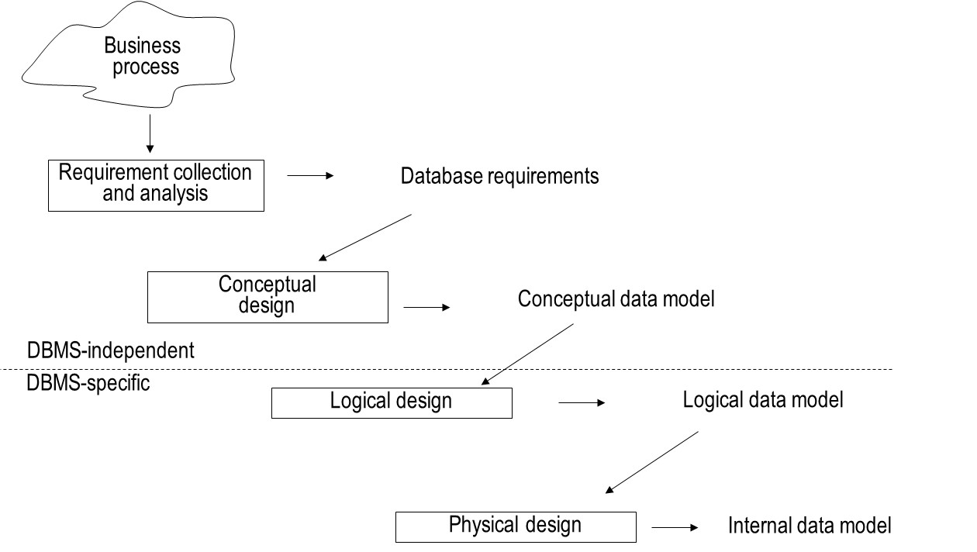
Phases of Database Design

Slide 20
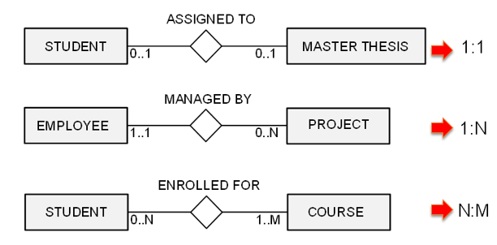
Entity Relationship (ER) model
Entity Types
Attribute Types
Relationship Types

Slide 21
Designing the ER Model
Identify the entity types
Identify the relationship types and assert their degree
Assert the cardinality ratios and participation constraints (total versus partial participation)
Identify the attribute types and assert whether they are simple or composite, single or multiple valued, derived or not
Link each attribute type to an entity type or a relationship type
Denote the key attribute type(s) of each entity type
Identify the weak entity type(s) and their partial keys

Slide 22
Normalization
Normalization is a process of organizing the data in database to avoid data redundancy and insertion, update and deletion anomaly.
A super key is a set of attributes which can uniquely identify a tuple.
The minimal set of attribute which can uniquely identify a tuple is known as candidate key (e.g., NetID).
An attribute that is a part of one of the candidate keys is known as prime attribute.
An attribute is not part of any candidate key known as non-prime attribute.
Primary key is a chosen candidate key for a table
Alternate keys are other candidate keys

Slide 23
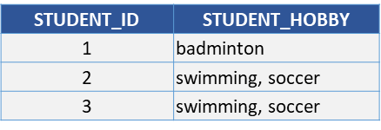
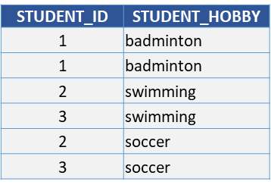

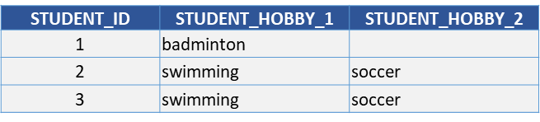
1NF – First Normal Form
Each attribute of a table must have atomic values
No repeated tuples (records or rows)
No repeated attributes (columns or fields)
No multi-value data (attribute value)
No repeated groups at the intersection of each row and column.

Slide 24
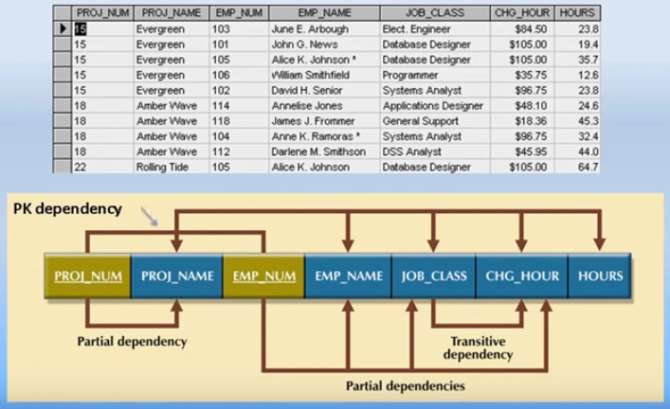
2NF and 3NF

Slide 25
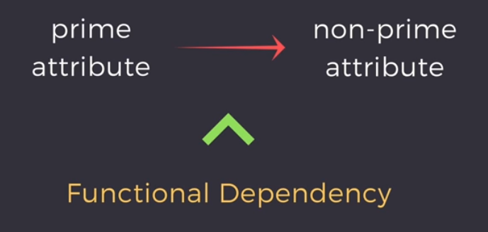
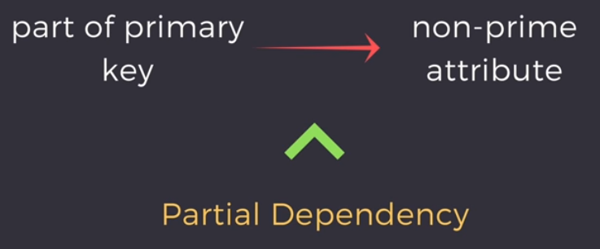
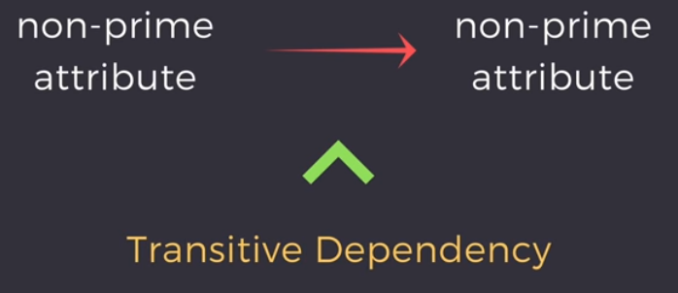
Attribute Dependency

Slide 26
Summary
1NF | No repeating groups in tuples (rows), attributes (columns) or values (data)
2NF | 1NF and no partial dependencies
3NF | 2NF and no transitive dependencies
3.5NF | 3NF and For any dependency A > B, A should be a super key.
4NF | 3NF or 3.5NF and no multivalued dependencies
5NF | 4NF and rejoining the table should not lose or gain tuples

Slide 27
Basic SQL
SQL
DDL
CREATE
ALTER
DML
SELECT
DROP
INSERT
UPDATE
DELETE
SELECT
attributes
FROM
entities (join)
WHERE
attributes
GROUP BY
attributes
HAVING
attributes
ORDER BY
attributes

Slide 28
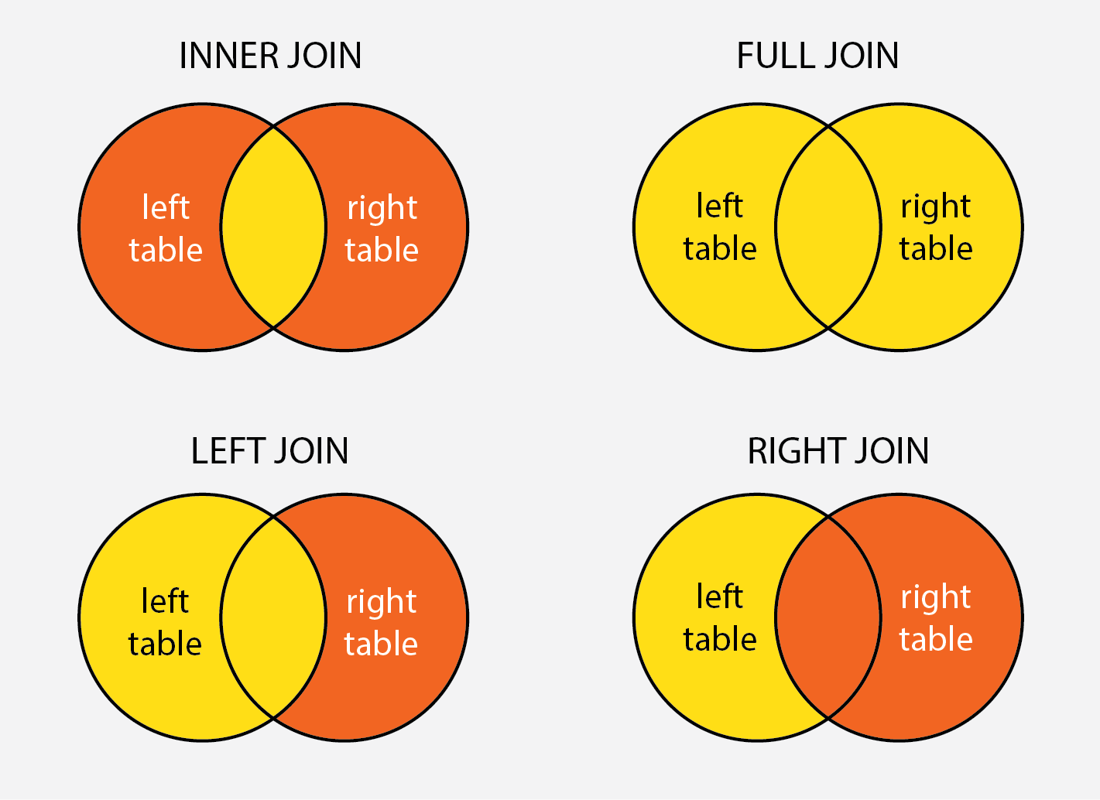
SQL Join Types

Slide 29
Advanced SQL
SQL Control-Flow Statements
Functions
Stored Procedures
Triggers
Cursors

Slide 30
SQL Control-Flow Statements
BEGIN TRANSACTION
BEGIN-END
IF-ELSE
WHILE-BREAK-CONTINUE
GOTO
RETURN
CASE
WAITFOR
TRY … CATCH
THROW

Slide 31
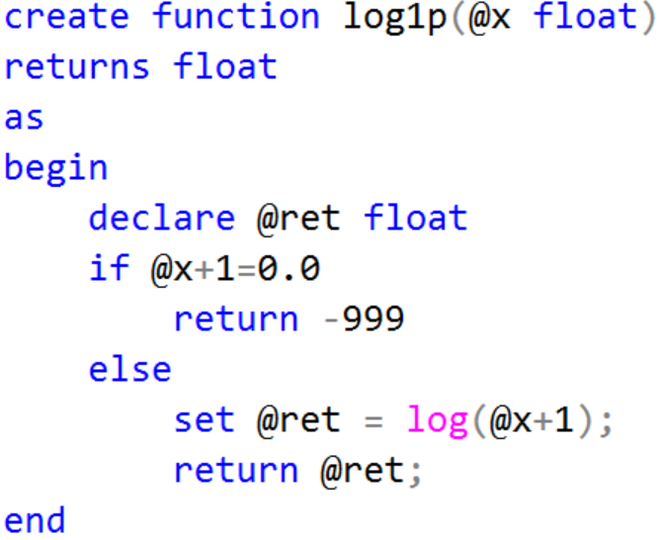
Create Function - Scalar

Slide 32
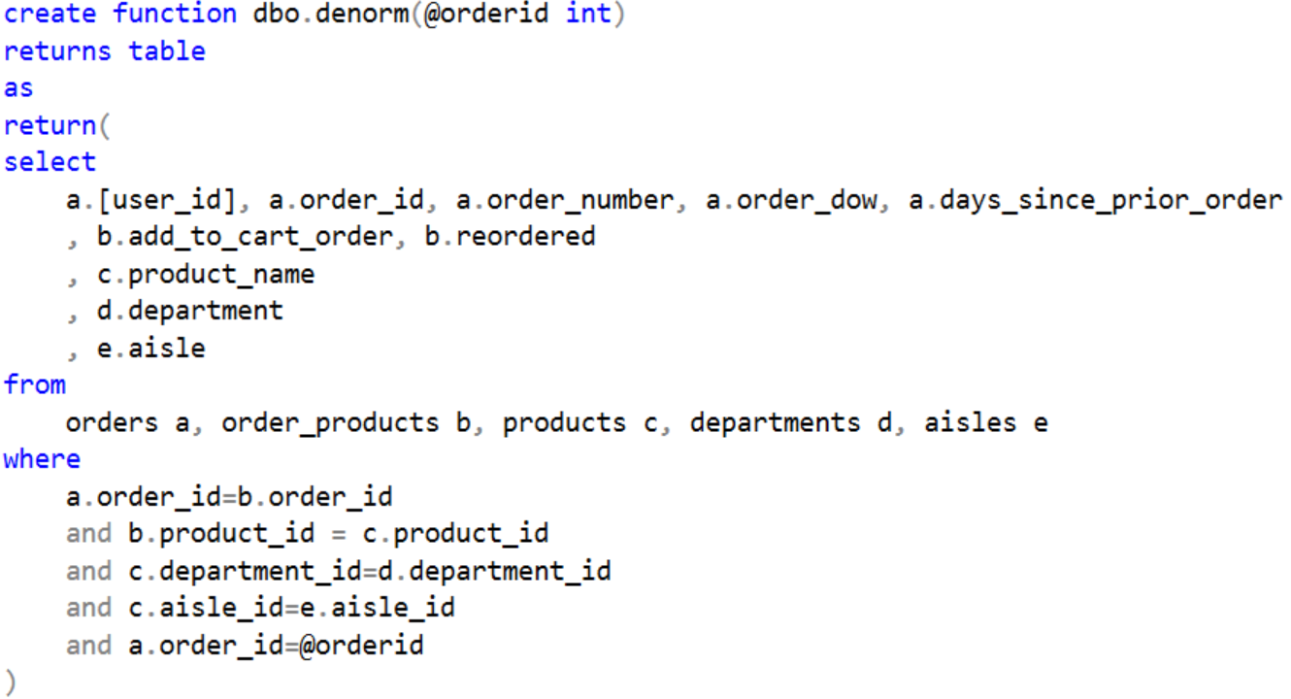
Create Function - Table

Slide 33
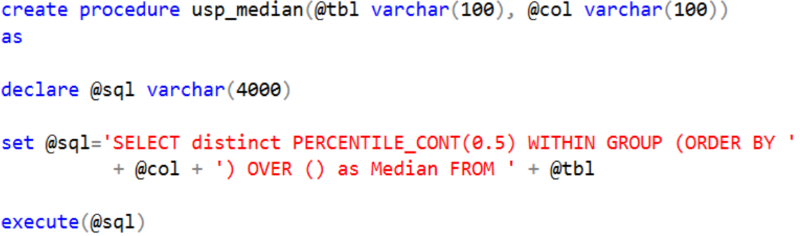
Stored Procedures – Scalar

Slide 34
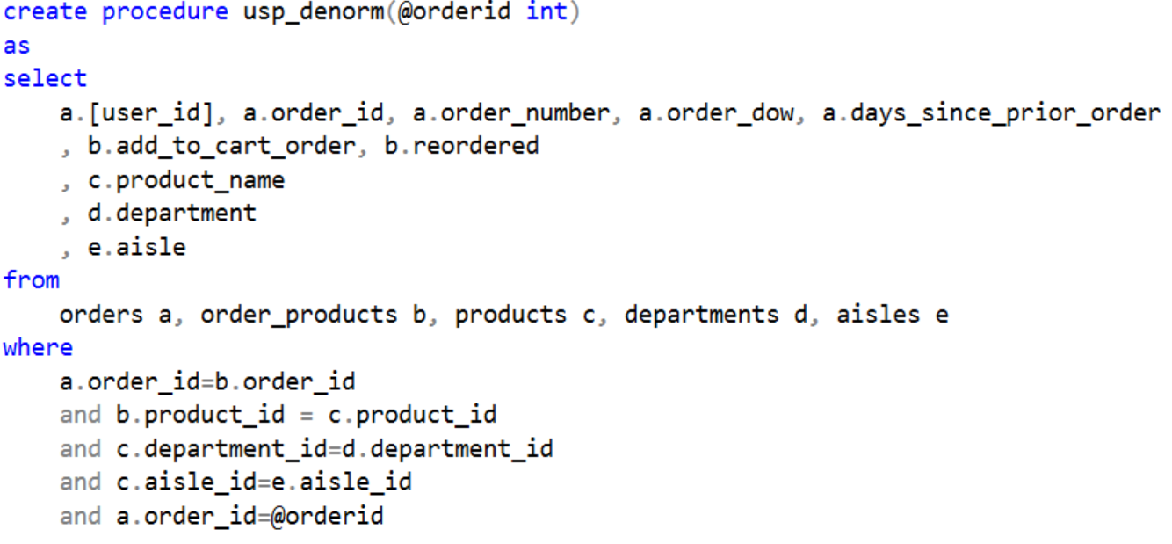
Stored Procedure – Table

Slide 35
DDL Triggers
A DDL trigger will be fired in response to different Data Definition Language (DDL) events, such as CREATE, ALTER, DROP T-SQL statements
Trigger Name
CREATE TRIGGER safety
ON DATABASE
FOR DROP_TABLE, ALTER_TABLE
AS
PRINT 'You must disable Trigger "safety" to drop or alter tables!'
ROLLBACK;
Events
Target
Actions

Slide 36
DML Triggers
A DML trigger will be fired in response to different Data Manipulation Language (DML) events, such as INSERT, UPDATE or DELETE action
The DML triggers can be used to maintain data integrity and enforce business rules by performing auditing processes and other post DML actions.
Trigger Name
CREATE TRIGGER reminder1
ON Products
AFTER INSERT, UPDATE
AS
RAISERROR ('Notify Management', 16, 10);
Timing
Target
Events
Actions

Slide 37
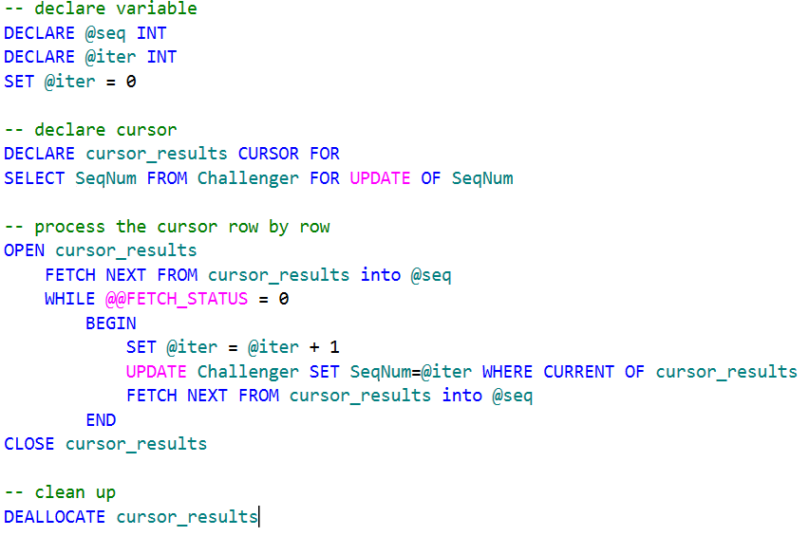
SQL Cursors – Example
Applications, especially interactive online applications, cannot always work effectively with the entire result set as a unit. These applications need a mechanism to work with one row or a small block of rows at a time.
Cursors are an extension to result sets that provide that mechanism.

Slide 38
Architectures for Parallel Databases
Interconnection Network
P
P
P
P
P
P
P
P
P
Interconnection Network
M
M
M
M
M
M
M
M
M
Interconnection Network
D
D
D
D
D
D
D
D
D
SHARED NOTHING
SHARED MEMORY
SHARED DISK

Slide 39
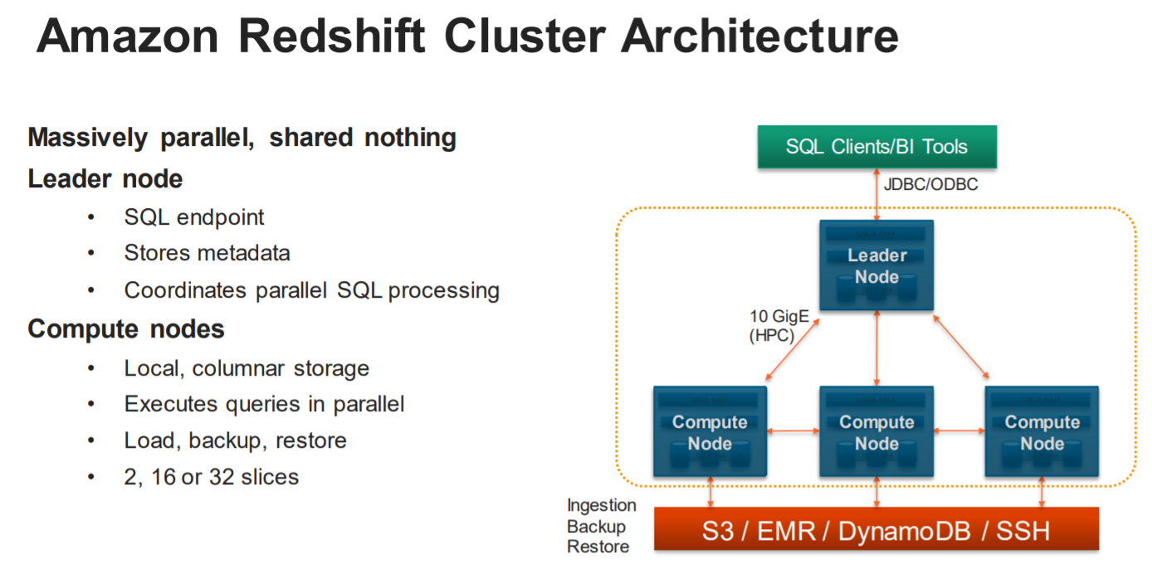

Slide 40
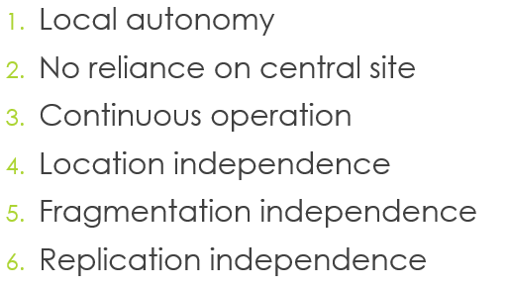
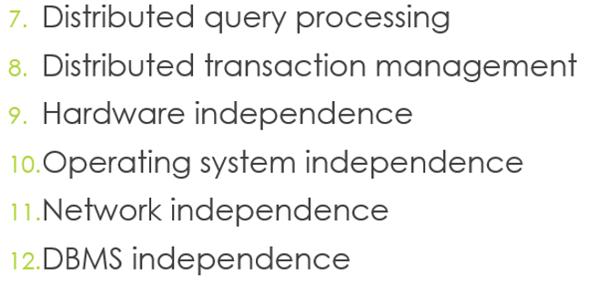
Distributed Databases – Date’s 12 Rules
Rule 0: to the user, a distributed system should look exactly like a non-distributed system
Autonomy, Independency and Transparency

Slide 41
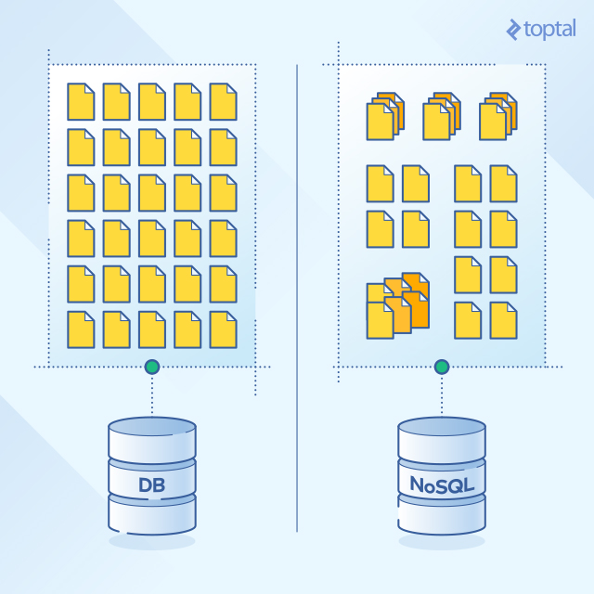
RDBMS against NoSQL

Slide 42
ACID vs BASE
All operations in a transaction succeed or every operation is rolled back.
The database appears to work most of the time.
ACID | BASE
Atomicity | Basically Available
Consistency | Soft state
Isolation | Eventual consistency
Durable
Stores do not have to be write-consistent, nor do different replicas have to be mutually consistent all the time.
At the end of the transaction, all data must be left in a consistent state.
Modifications of data performed by a transaction must be independent of another transactions.
The results of applying a transaction are permanent, even in the presence of failures.
Stores exhibit consistency at some later point.

Slide 43
NoSQL Categories
There are four general types (most common categories) of NoSQL databases. Each of these categories has its own specific attributes and limitations. There is not a single solutions which is better than all the others, however there are some databases that are better to solve specific problems.
Key-Value stores
Document oriented
Column-oriented
Graph

Slide 44
Replication and Sharding
Replication copies the entire database across all nodes in the distributed system.
Sharding divides the data inside the database and partitions pieces of it to different nodes. Databases can be sharded horizontally (by rows) or vertically (by columns).

Slide 45
Relational & NoSQL data models
Relational model | Document model | Column-oriented | Graph model
Tables | Collections | Tables | Nodes
Rows | Documents | Rows | Nodes?
Columns | Key/value pairs | Columns | Node Attributes
Relationships | Embedded docs | Relationships | Relationships
MySQL | MongoDB | Redshift | neo4j

Slide 46
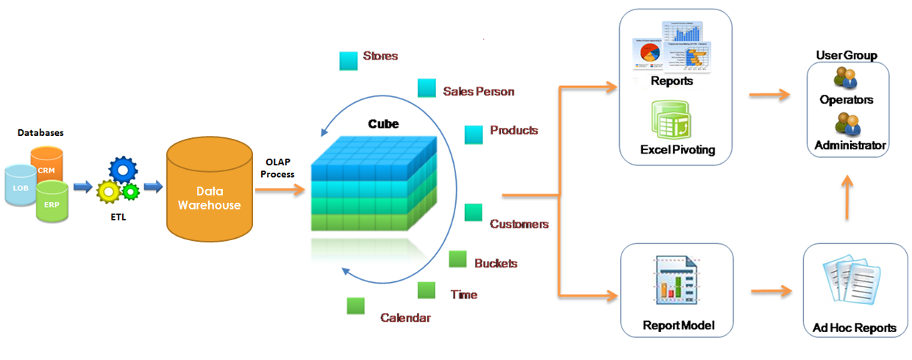
Data for Decision Making
Business Intelligence(BI)

Slide 47
Data Warehouse
“A data warehouse (DW or DWH) is a subject-oriented, integrated, time-variant, and nonvolatile collection of data in support of management’s decision-making process.” (Inmon, 1996)
In computing, a data warehouse, also known as an enterprise data warehouse (EDW), is a system used for reporting and data analysis, and is considered a core component of business intelligence
DWs are central repositories of integrated data (current and historical ) from one or more disparate sources

Slide 48
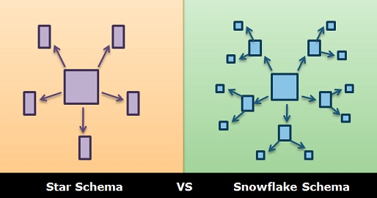
Data Warehouse Schemas
Star schema
Snowflake schema

Slide 49
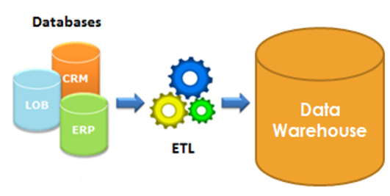
Extract, Transform, Load (ETL) Process
Capture data from multiple, heterogeneous sources and integrate into a single persistent store
ETL activities
extract data
transform data
load transformed data
Can consume up to 80% of all efforts needed to set up a data warehouse

Slide 50
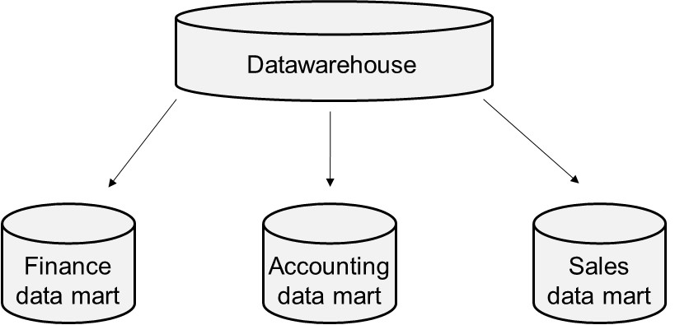
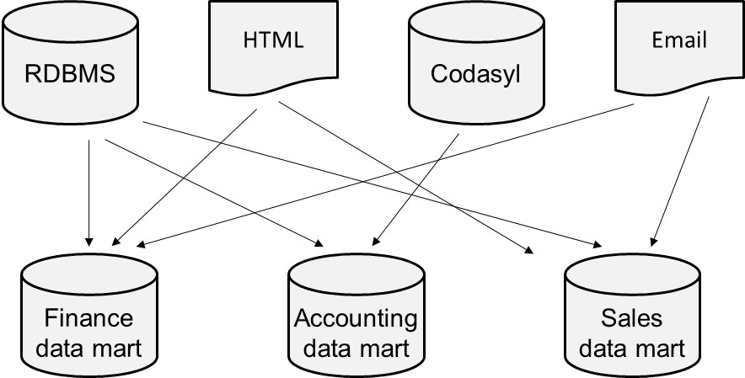
Data Marts
A data mart is a scaled down version of a data warehouse aimed at meeting the information needs of a homogeneous small group of end-users such as a department or business unit
Provide focused content + improve query performance
Dependent data marts pull their data directly from a central data warehouse
Independent data marts are standalone systems drawing data directly from the operational systems, external sources or a combination of both

Slide 51
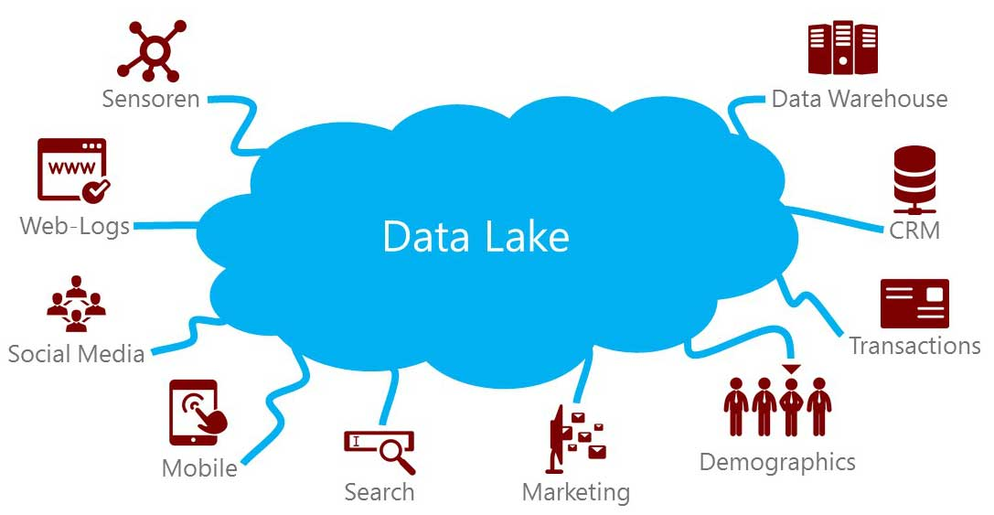
Data Lake
A data lake is a centralized repository that allows you to store all your structured and unstructured data at any scale
You can store your data as-is, without having to first structure the data, and run different types of analytics—from dashboards and visualizations to big data processing, real-time analytics, and machine learning to guide better decisions

Slide 52
Business Intelligence
Business intelligence (BI) is referred to as the set of activities, techniques and tools aimed at understanding patterns in past data and predicting the future.
It’s all about Data. Garbage In, Garbage Out (GiGo)
BI techniques
(Ad hoc) Query and Reporting
Pivot tables
OLAP
Data Mining

Slide 53
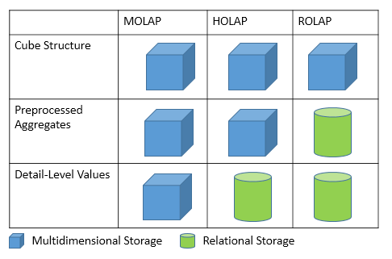
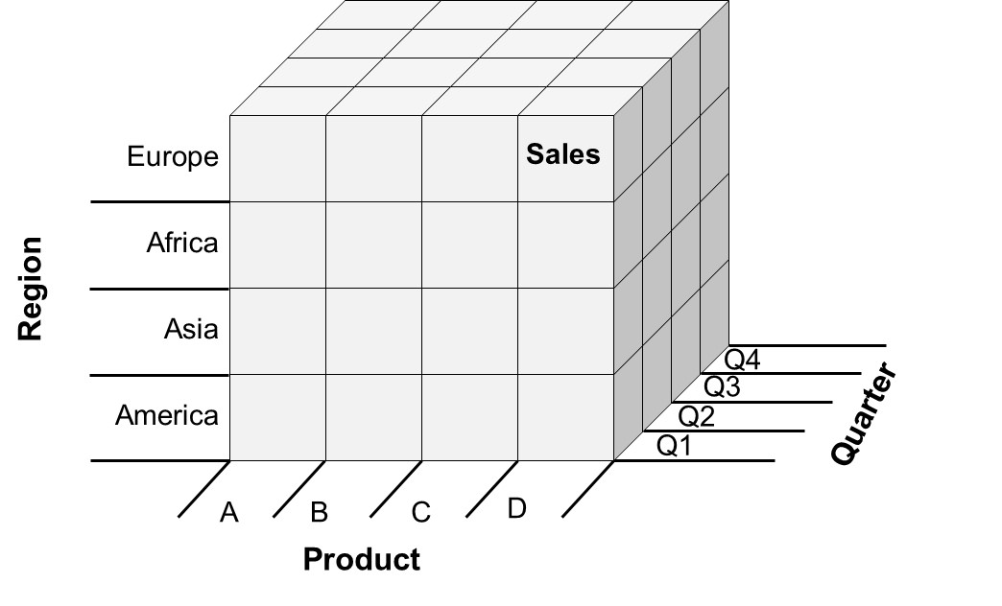
MOLAP, ROLAP and HOLAP

Slide 54
OLAP operators
PRODUCT | QUARTER | REGION | SALES
A | Q1 | Europe | 10
A | Q1 | America | 20
A | Q2 | Europe | 20
A | Q2 | America | 50
A | Q3 | America | 20
A | Q4 | Europe | 10
A | Q4 | America | 30
B | Q1 | Europe | 40
B | Q1 | America | 60
B | Q2 | Europe | 20
B | Q2 | America | 10
B | Q3 | America | 20
B | Q4 | Europe | 10
B | Q4 | America | 40

Slide 55
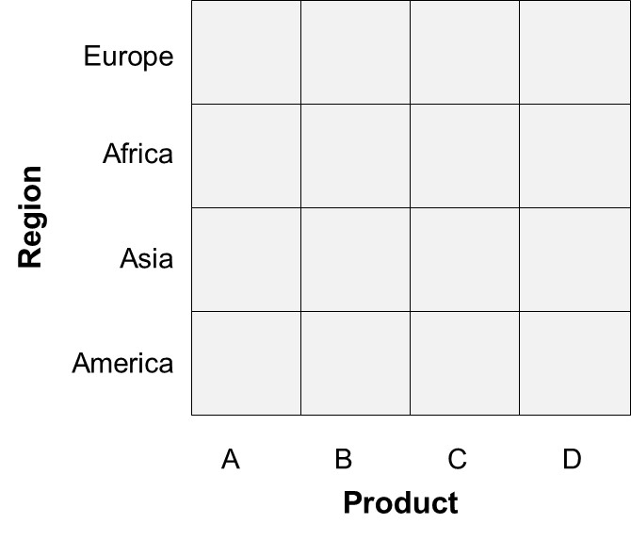
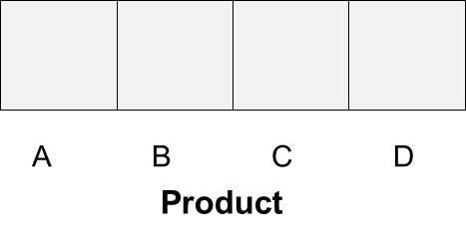
OLAP operators – Roll-up & Drill-down
Drill-up (Roll-up) refers to aggregating the current set of fact values within or across one or more dimensions.
Drill Down refers to zoom in to more detailed data.
Roll-up
Sales
Sales
Drill-down

Slide 56
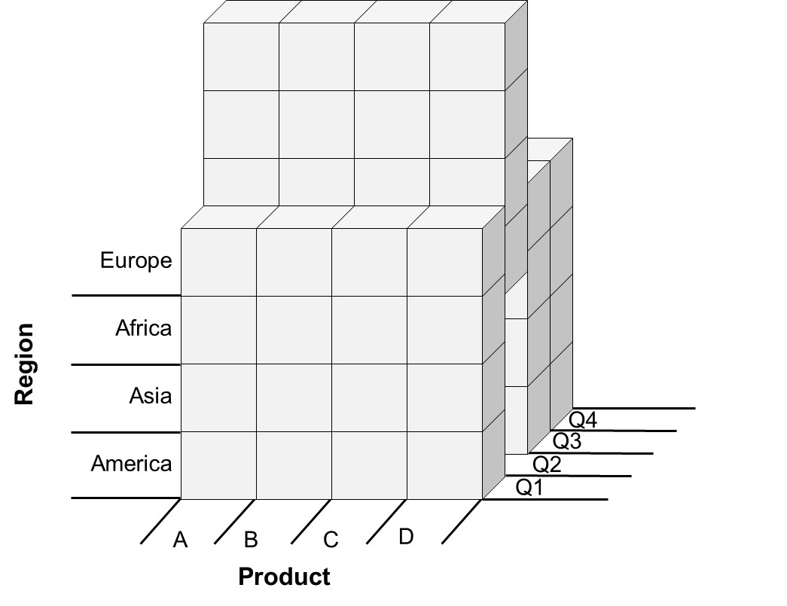
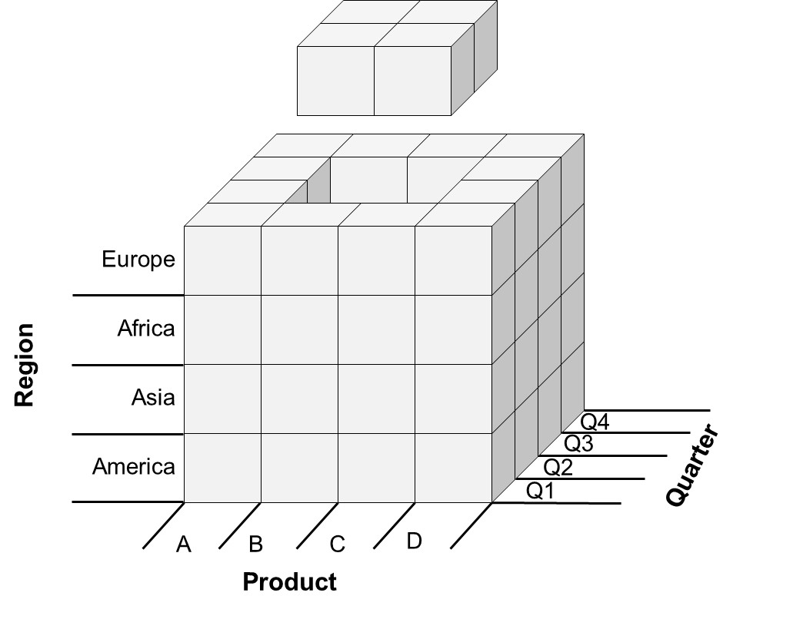
OLAP operators – Slicing & Dicing
Slicing represents the operation whereby one of the dimensions is set at a particular value.
Dicing corresponds to a range selection on one or more dimensions
Quarter

Slide 57
OLAP queries in SQL – GROUP BY CUBE
PRODUCT | QUARTER | REGION | SALES
A | Q1 | Europe | 10
A | Q1 | America | 20
A | Q2 | Europe | 20
A | Q2 | America | 50
A | Q3 | America | 20
A | Q4 | Europe | 10
A | Q4 | America | 30
B | Q1 | Europe | 40
B | Q1 | America | 60
B | Q2 | Europe | 20
B | Q2 | America | 10
B | Q3 | America | 20
B | Q4 | Europe | 10
B | Q4 | America | 40
The CUBE operator computes a union of GROUP BY’s on every subset of the specified attribute types
QUARTER | REGION | SALES
Q1 | Europe | 50
Q1 | America | 80
Q2 | Europe | 40
Q2 | America | 60
Q3 | Europe | NULL
Q3 | America | 40
Q4 | Europe | 20
Q4 | America | 80
Q1 | NULL | 130
Q2 | NULL | 100
Q3 | NULL | 40
Q4 | NULL | 90
NULL | Europe | 110
NULL | America | 250
NULL | NULL | 360
SELECT QUARTER, REGION, SUM(SALES) FROM SALESTABLE GROUP BY CUBE (QUARTER, REGION)

Slide 58
OLAP queries in SQL – GROUP BY ROLLUP
PRODUCT | QUARTER | REGION | SALES
A | Q1 | Europe | 10
A | Q1 | America | 20
A | Q2 | Europe | 20
A | Q2 | America | 50
A | Q3 | America | 20
A | Q4 | Europe | 10
A | Q4 | America | 30
B | Q1 | Europe | 40
B | Q1 | America | 60
B | Q2 | Europe | 20
B | Q2 | America | 10
B | Q3 | America | 20
B | Q4 | Europe | 10
B | Q4 | America | 40
QUARTER | REGION | SALES
Q1 | Europe | 50
Q1 | America | 80
Q2 | Europe | 40
Q2 | America | 60
Q3 | Europe | NULL
Q3 | America | 40
Q4 | Europe | 20
Q4 | America | 80
Q1 | NULL | 130
Q2 | NULL | 100
Q3 | NULL | 40
Q4 | NULL | 90
NULL | NULL | 360
SELECT QUARTER, REGION, SUM(SALES) FROM SALESTABLE GROUP BY ROLLUP (QUARTER, REGION)

Slide 59
OLAP queries in SQL – GROUPING SETS
GROUPING SETS operator generates a result set equivalent to that generated by a UNION ALL of multiple simple GROUP BY clauses
SELECT QUARTER, REGION, SUM(SALES) FROM SALESTABLE GROUP BY GROUPING SETS ((QUARTER), (REGION))
SELECT QUARTER, NULL, SUM(SALES) FROM SALESTABLE GROUP BY QUARTER UNION ALL SELECT NULL, REGION, SUM(SALES) FROM SALESTABLE GROUP BY REGION

Slide 60
OLAP Queries in SQL
SQL2003 introduced support for 2 types of other activities:
Ranking
RANK(): returns the rank of each row within the partition of a result set.
DENSE_RANK(): returns the rank of each row within a result set partition, with no gaps in the ranking values.
PERCENT_RANK(): calculates the relative rank of a row within a group of rows.
CUME_RANK(): calculates the cumulative distribution of a value within a group of values.
Windowing (Partition By)

Slide 61
OLAP Queries in SQL – RANK()
SELECT
PRODUCT, SALES , RANK() OVER (ORDER BY SALES ASC) as RANK_SALES , DENSE_RANK() OVER (ORDER BY SALES ASC) as DENSE_RANK_SALES
, PERCENT_RANK() OVER (ORDER BY SALES ASC) as PERC_RANK_SALES
, CUME_DIST() OVER (ORDER BY SALES ASC) as CUM_DIST_SALES FROM
SALESTABLE ORDER BY
RANK_SALES ASC

Slide 62
OLAP Queries in SQL - Windowing
SELECT
QUARTER, REGION, SALES
, AVG(SALES) OVER (PARTITION BY REGION ORDER BY QUARTER ROWS BETWEEN 1 PRECEDING AND 1 FOLLOWING) AS SALES_AVG FROM
SALESTABLE ORDER BY
REGION, QUARTER, SALES_AVG
QUARTER | REGION | SALES
1 | America | 10
2 | America | 20
3 | America | 10
4 | America | 30
1 | Europe | 10
2 | Europe | 20
3 | Europe | 10
4 | Europe | 20
QUARTER | REGION | SALES | SALES_AVG
1 | America | 10 | 15
2 | America | 20 | 13,33
3 | America | 10 | 20
4 | America | 30 | 20
1 | Europe | 10 | 15
2 | Europe | 20 | 13,33
3 | Europe | 10 | 16,67
4 | Europe | 20 | 15

Slide 63
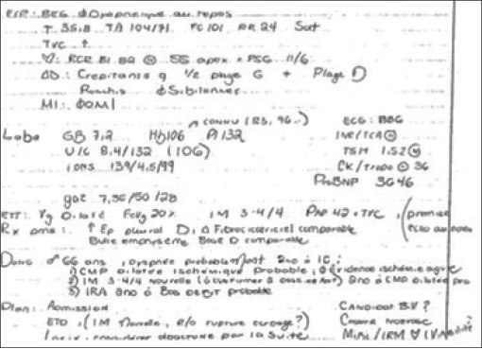
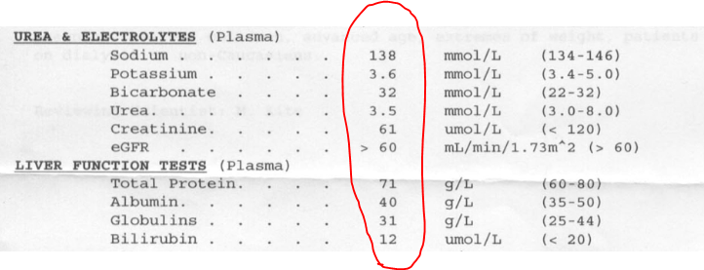
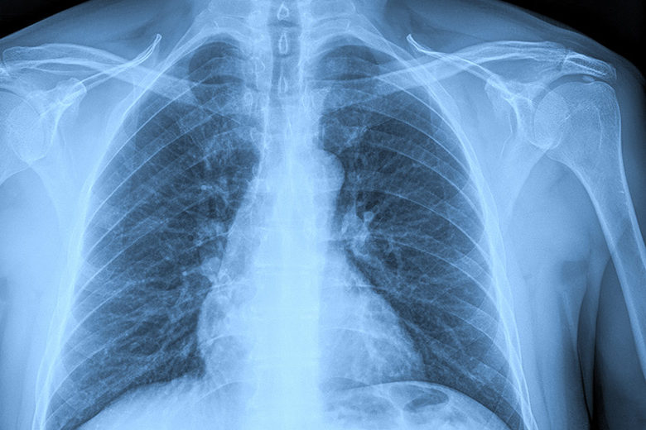

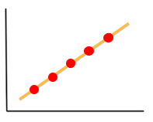
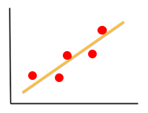
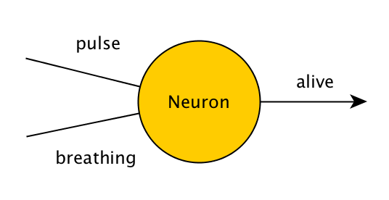
N
C
NN
CC
NC
Math
Stat
AI
Univariate
Bivariate
ML
Numerical
Measurement
DM
Explain the past
Exploration
Text
Image
Data Science
Sound
Categorical
Counting
Predict the future
Modeling
Supervised
Unsupervised
N
C
Clustering
Regression
Classification

Slide 64

The future is bright and beautiful. Love it, strive for it and work hard and smart for it.

